Slide 1

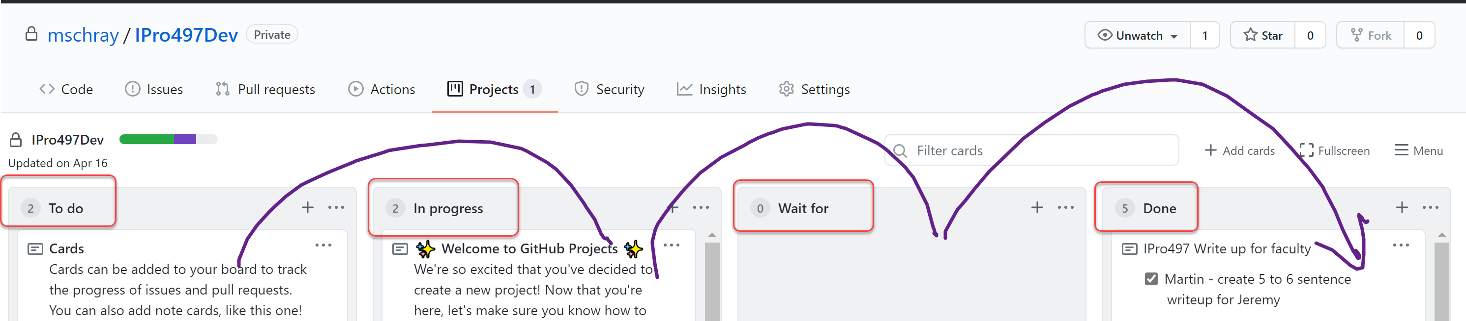
Kanban 201 – Agile Process

Slide 2
Kanban the Agile methodology
Kanban the Agile methodology
modelled after an assembly line, which is a continuous flow system
Has two key artifacts:
Backlog – stories of things to be done
Product Increment (PI) – demoable product
Roles: Developer, Product Owner and Scrum Master (e.g., the team)
Ceremonies
Planning – what goes into the next product increment
Stand up (daily scrum) – what progress have you made since yesterday?, What will you be doing today?, What issues are standing in your way?
Demo – demo of the Product Increment
Retrospective – team feedback on how to make things better and more productive

Slide 3
Kanban the Agile methodology IPRO 497
Roles: Doers & Project Manager/Doer (PM – team faciliatory)
Ceremonies
Stand up (in-class scrum) –
what progress have you made since last class?
What will you be doing today?
What issues are standing in your way?
Planning – What the PM does before faculty
Demo –
Kanban board walk – Each person talks about their work for one minute
Tech demo
Retrospective – NA

Slide 4
Kanban Board
Please use the following columns for your board
To do
In progress
Wait for
Done

Slide 5

Work in Progress (WIP)
Limiting work in progress (WIP) is good.
You can only make progress on a few things
There is a cost of switching from task to task
Try to limit WIP to 1 to 2 stories per individual
If you are tempted to bring in more stories you are probably avoiding or blocked on a story

Slide 6
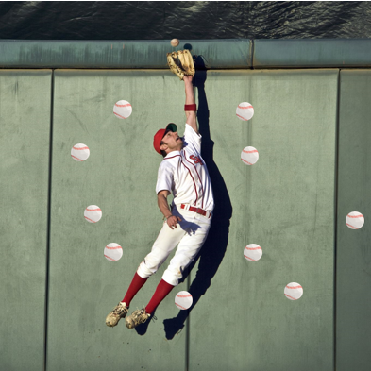
Work in Progress (WIP)
If you don’t limit work in progress things get missed, dropped, done poorly
Overall speed of completion may drop

Slide 7
Kanban Board
Please use the following columns for your board
To do
In progress
Wait for
Done
Limit your WIP

Slide 8
Background and resources
https://www.atlassian.com/agile/kanban/boards
https://natthompson.com/what-is-kanban/#:~:text=Kanban%20Ceremonies%201%20Planning.%20During%20planning%20the%20Kanban,simple%20questions.%203%20Demo.%20...%204%20Retrospective.%20
Limit your WIP - https://youtu.be/zEJn6eQO6FE

Slide 9
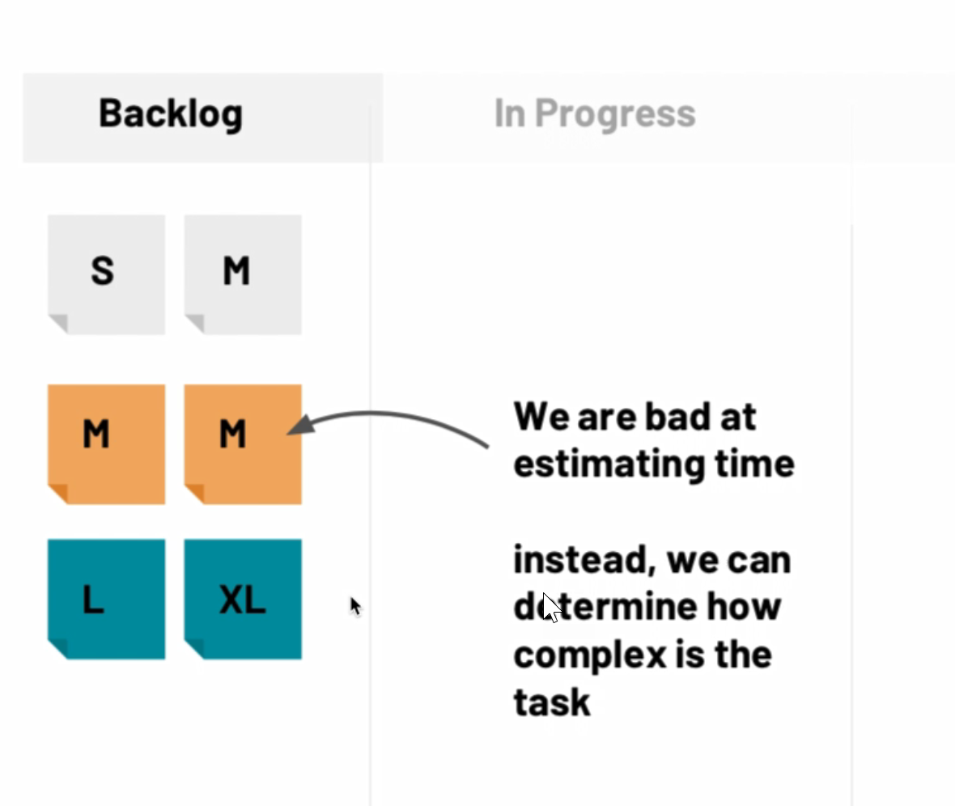
Sizing your work

